Slide 1
DELE CA1

Slide 2
Process
Data visualisation
Data cleaning
Data augmentation
Modelling and evaluation
Hyperparameter tuning

Slide 3
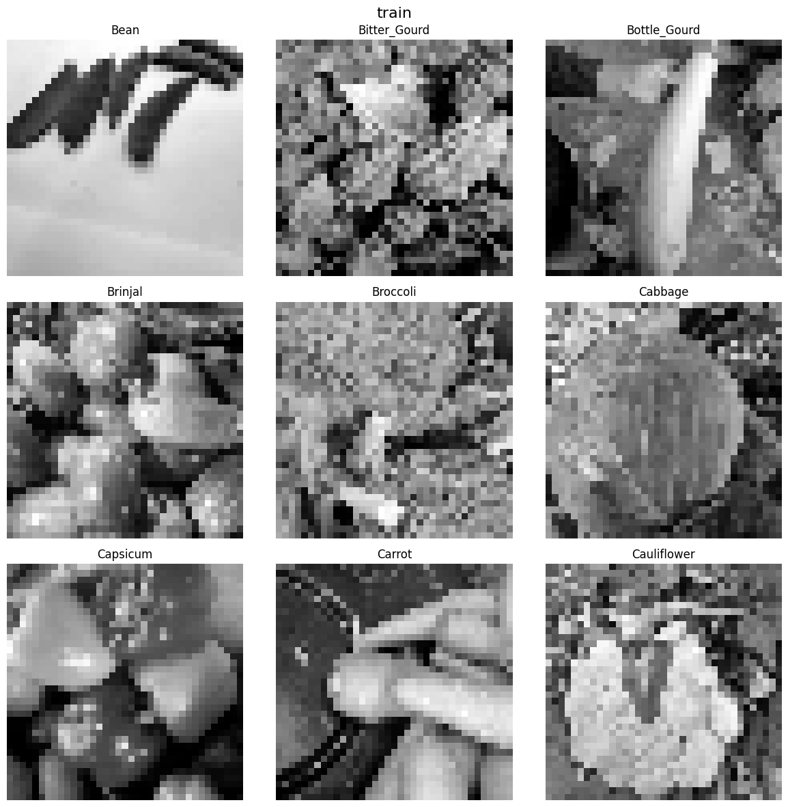
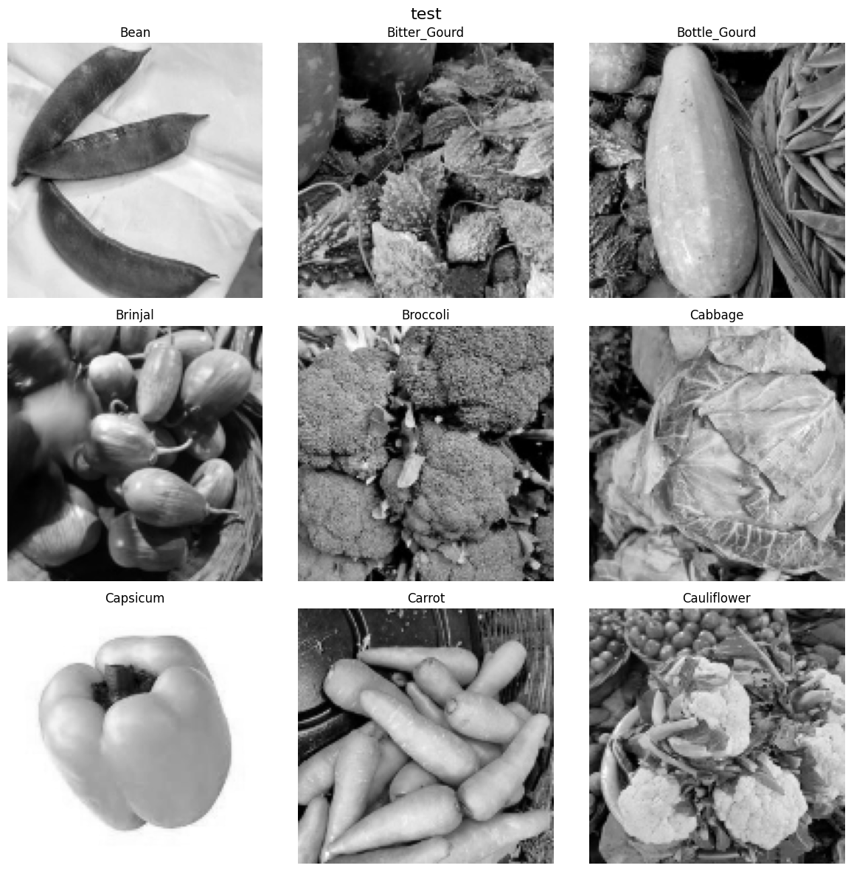
Data visualisation:
Here we can see some images from our dataset

Slide 4
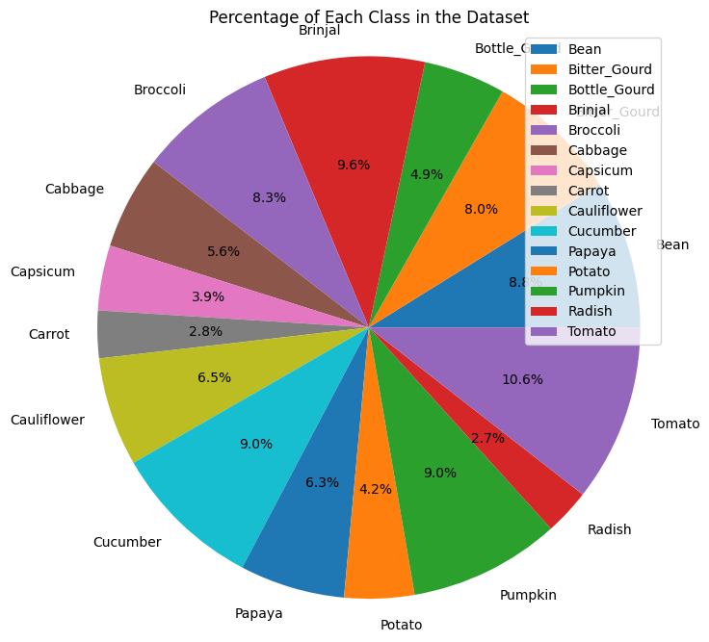
Data visualization
The image classes are not balanced for the training set, I will try to solve this later

Slide 5
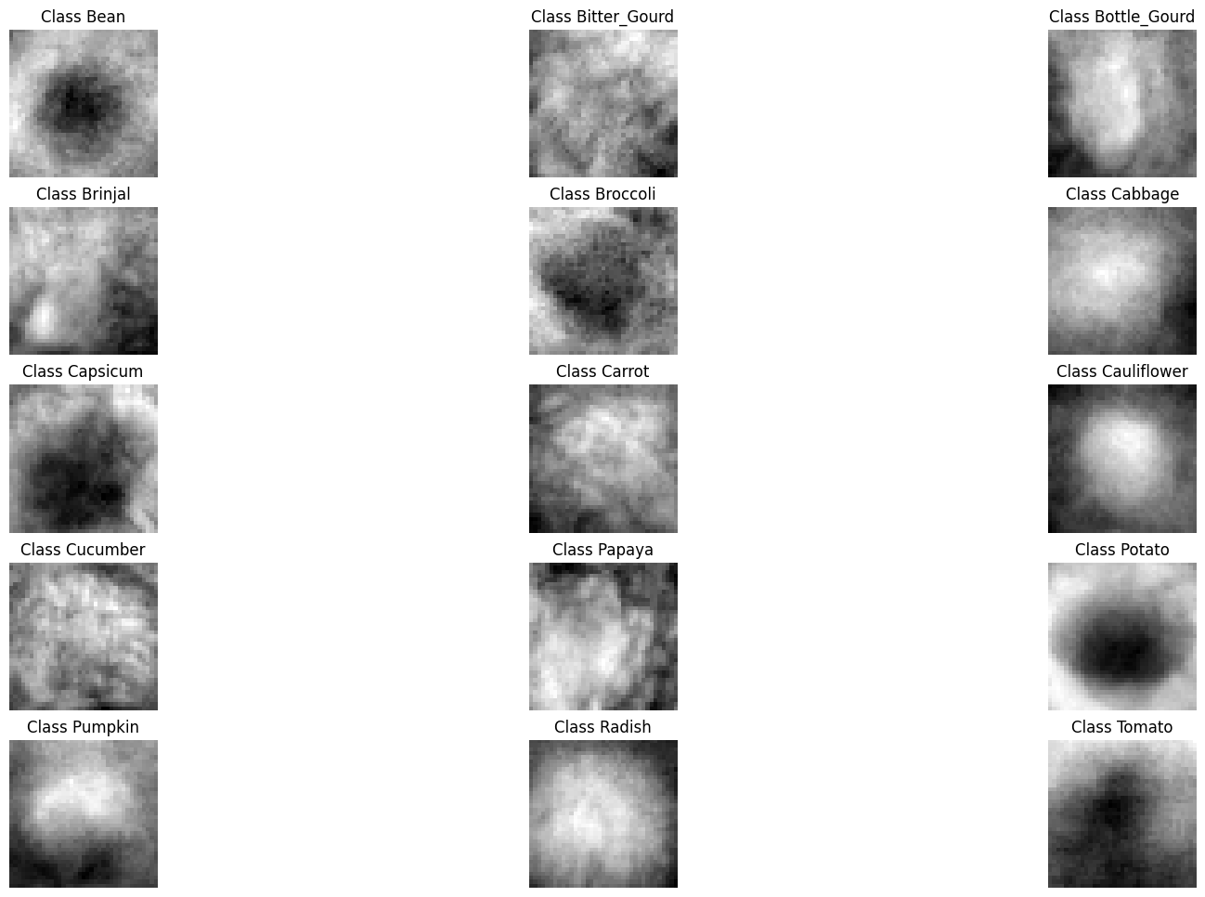
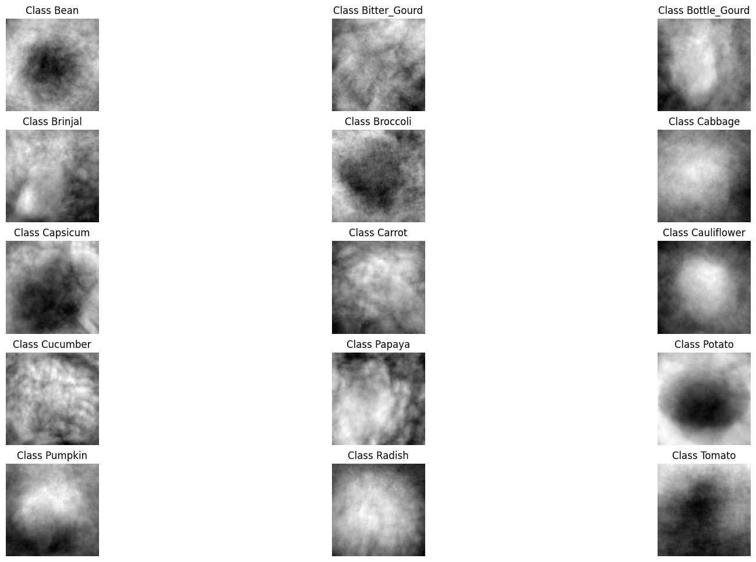
The average image in the dataset
We can see that there is some differences in the images, which is good as the model can predict
37
131

Slide 6
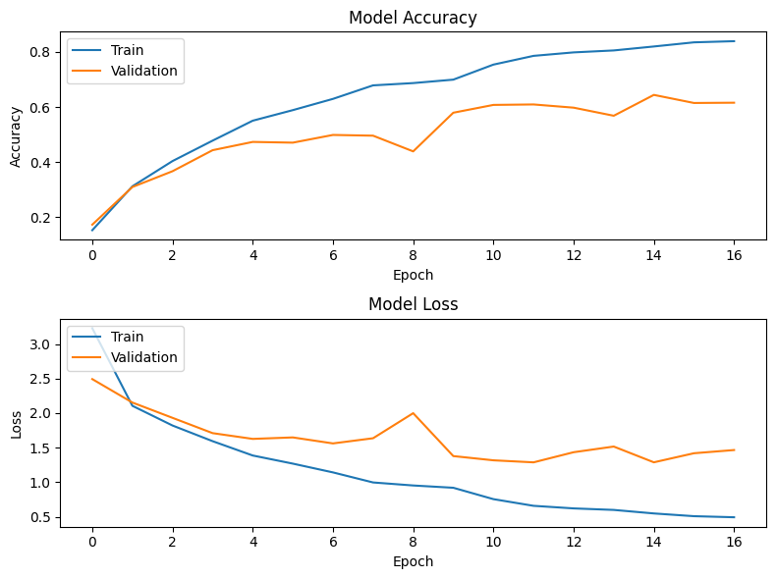
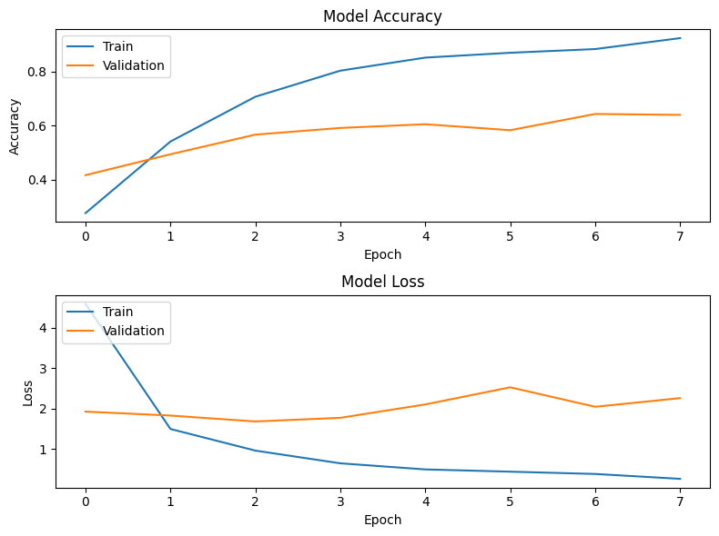
Prelimenary baseline model
37x37
131x131

Slide 7
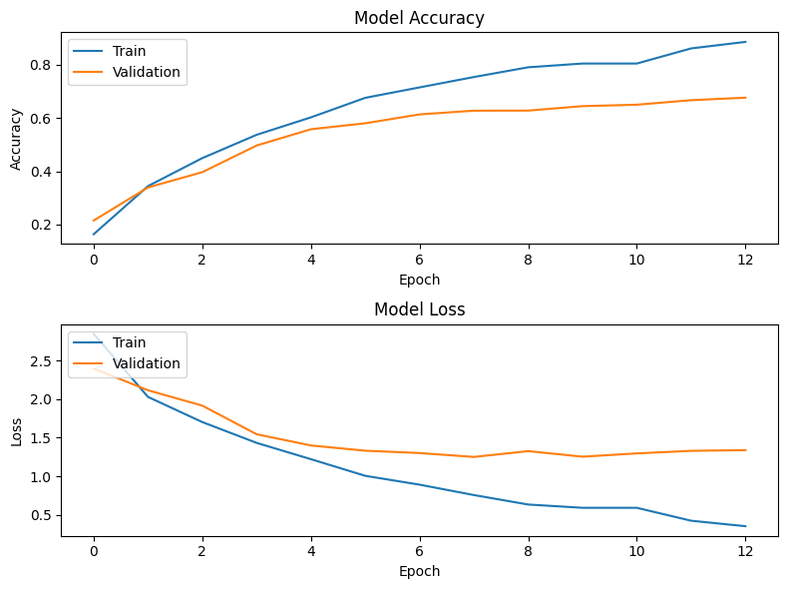
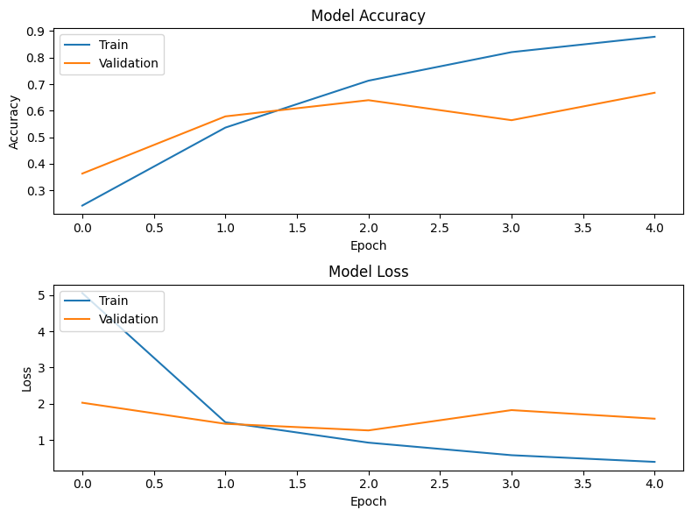
After remove anomalous data
37
131

Slide 8
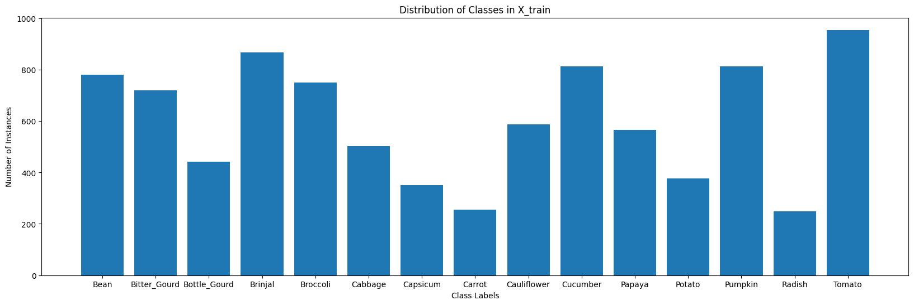
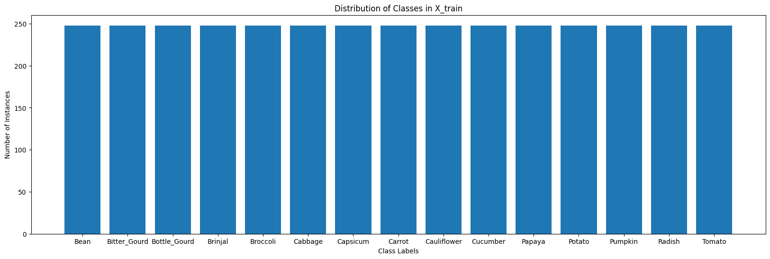
Equalising the classes
Used underfitting but got very poor results

Slide 9
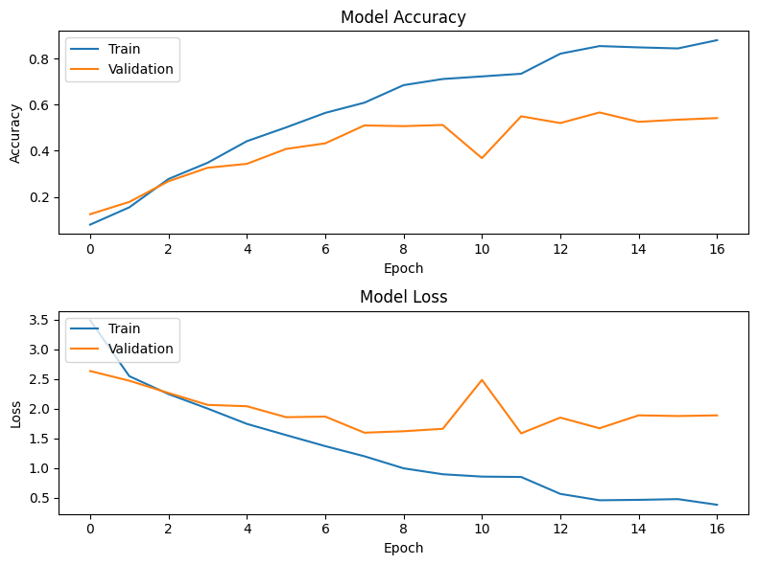
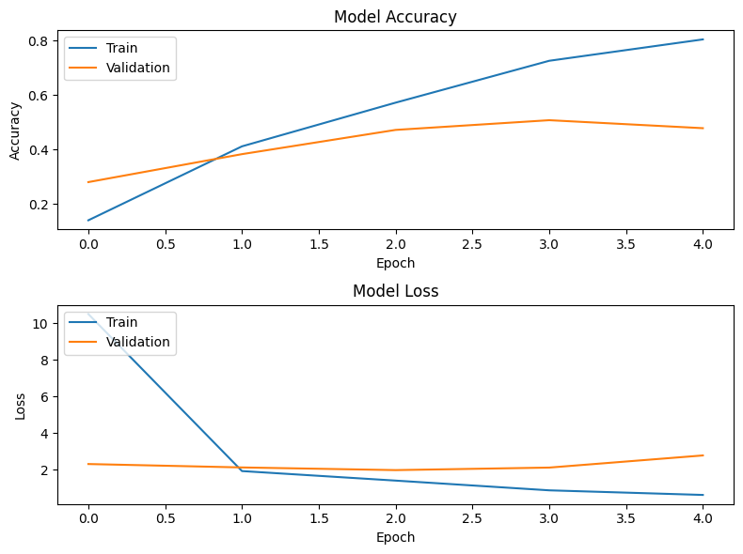
undersampling

Slide 10
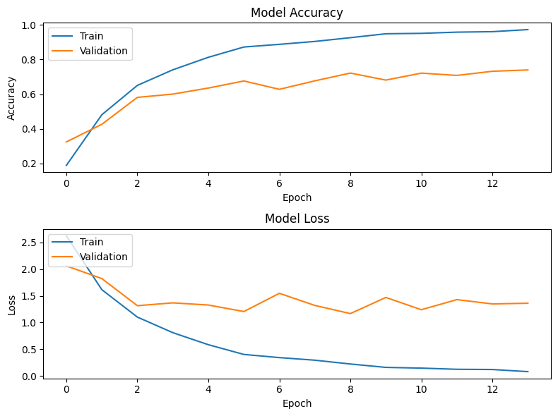
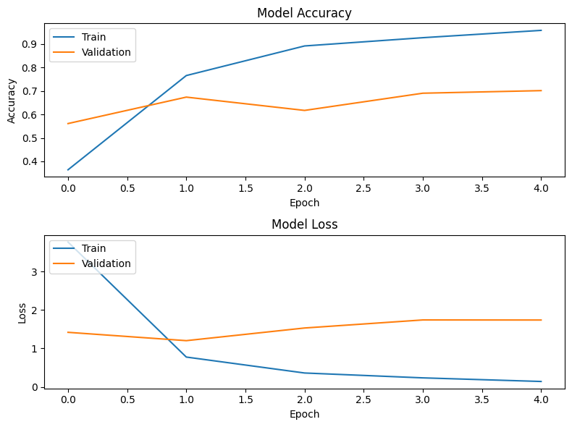
oversampling
Slightly better but still poor

Slide 11
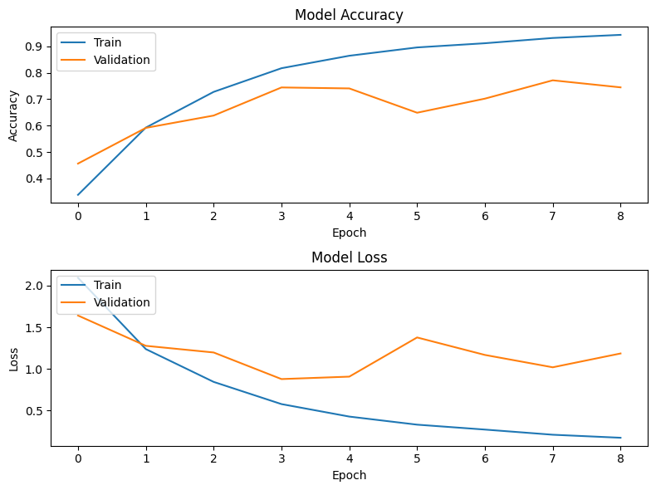
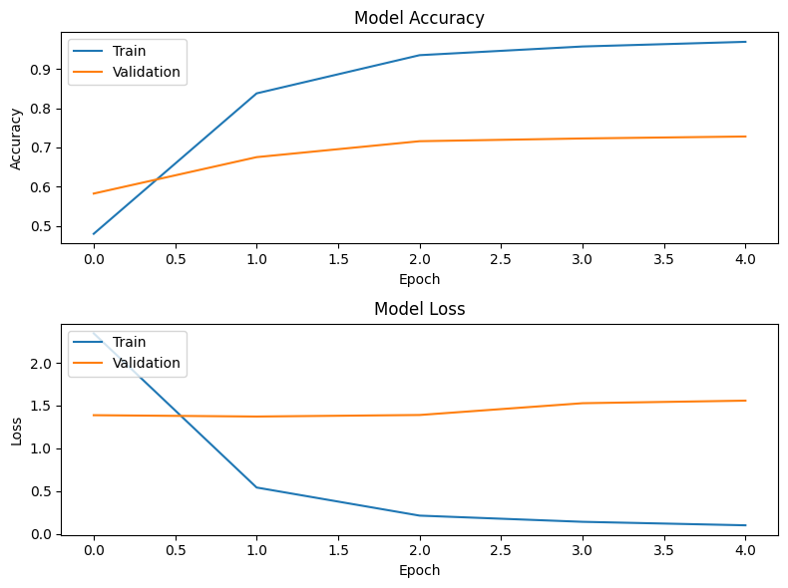
augmentation

Slide 12
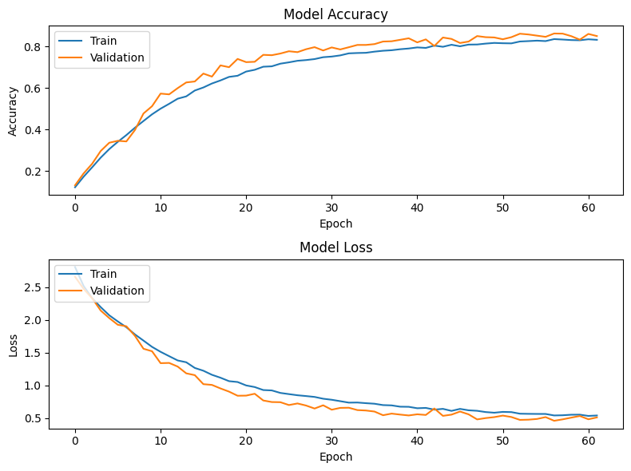
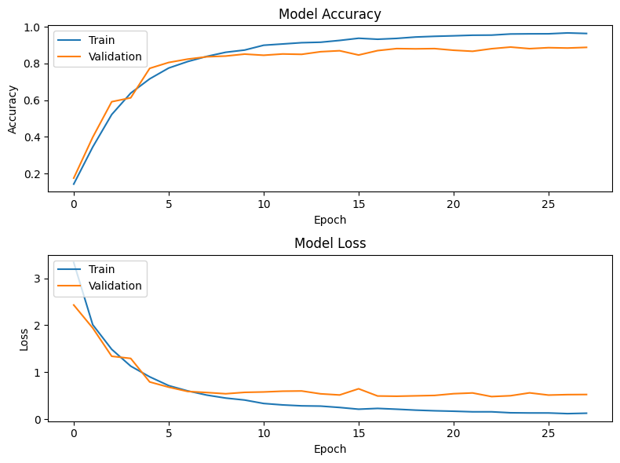
Add dropout
37
131

Slide 13
accuracies
pre anomaly removal (37x37)= val_accuracy: 0.6157 - val_loss: 1.4651
pre anomaly removal (131x131)= val_accuracy: 0.6390 - val_loss: 2.2543
post anomaly removal(37x37)= val_accuracy: 0.6760 - val_loss: 1.3388
post anomaly removal (131x131)=val_accuracy: 0.6677 - val_loss: 1.5861
post undersampler (37x37)=val_accuracy: 0.5420 - val_loss: 1.8844
post undersampler (131x131)= val_accuracy: 0.4780 - val_loss: 2.7832
post oversampler (37x37)=val_accuracy: 0.7400 - val_loss: 1.3614
post oversampler (131x131)=val_accuracy: 0.7013 - val_loss: 1.7370
post augment (37x37)= val_accuracy: 0.7447 - val_loss: 1.1858
post augment(131x131)= val_accuracy: 0.7280 - val_loss: 1.5572

Slide 14
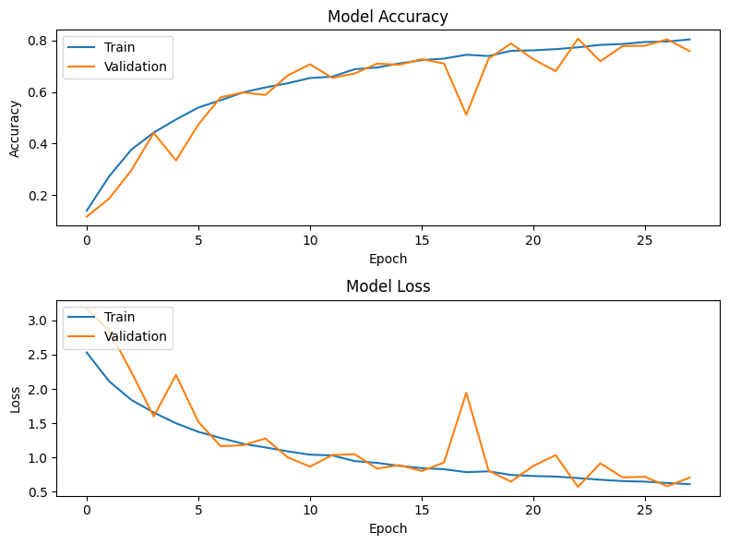
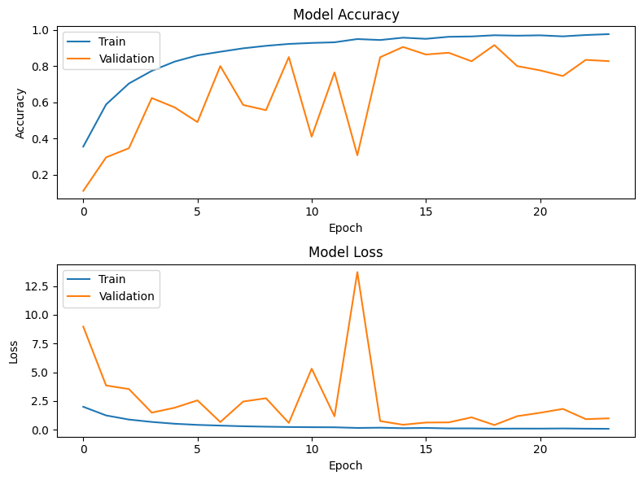
Dropout and normalization
Very unstable so I didn’t proceed with this

Slide 15
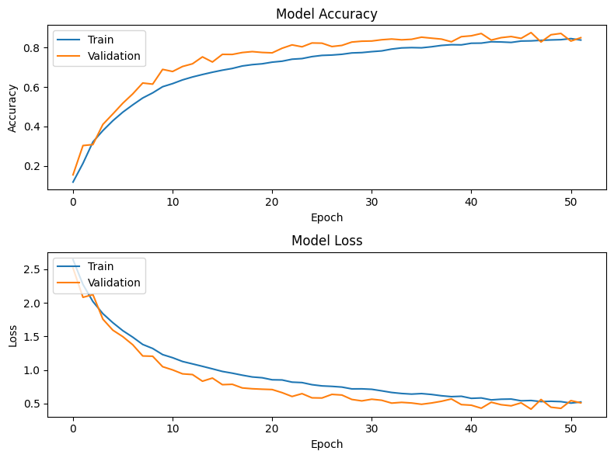
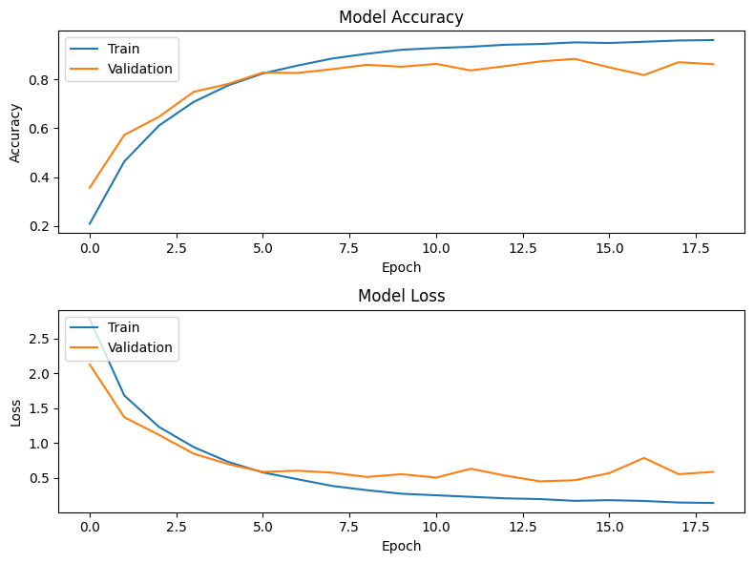
Adding layers

Slide 16
Final after hyperparamtune
Final 37x37
Final 131x131

Slide 17
Part B

Slide 18
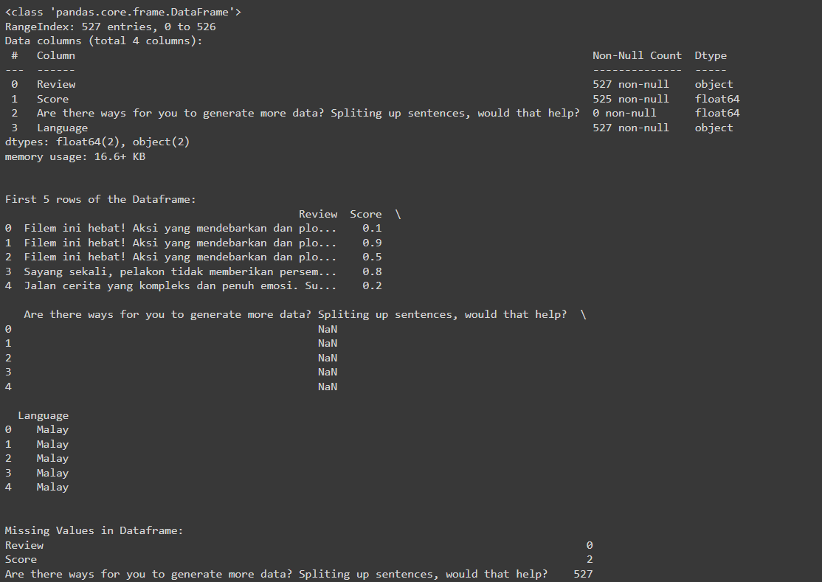
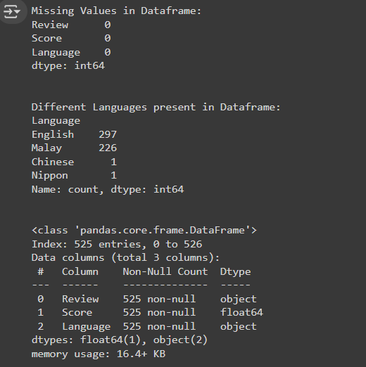
Data visualization

Slide 19
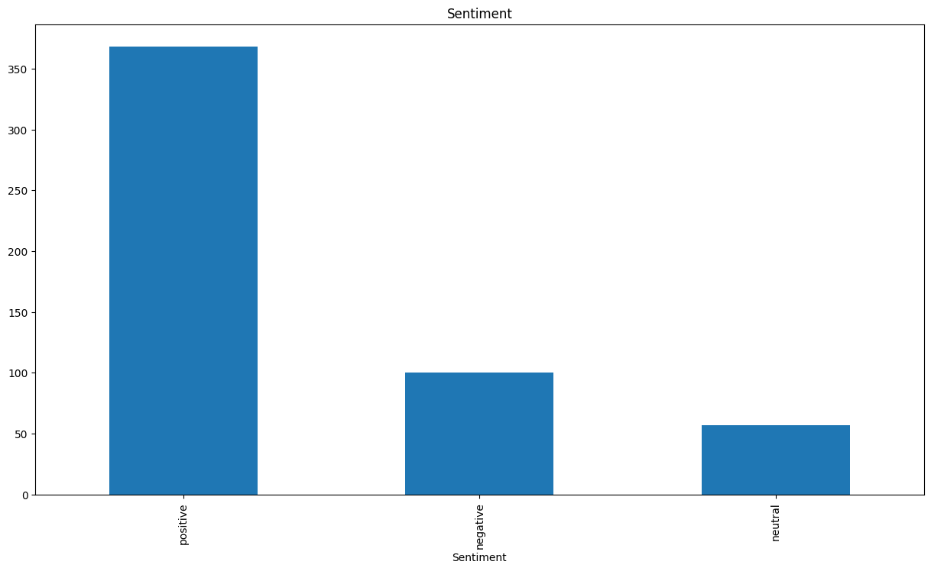
Distribution of sentiment

Slide 20
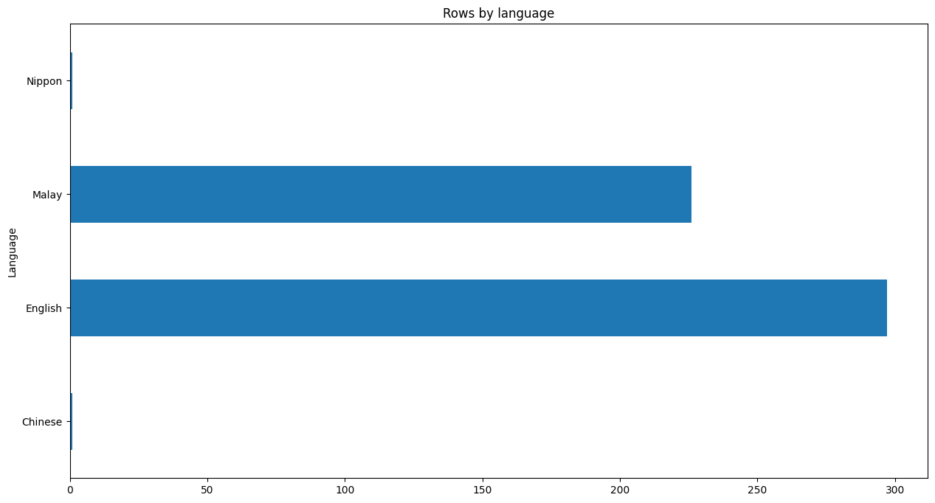
Distribution of language
Since nippon and Chinese only one record, I drop them both

Slide 21
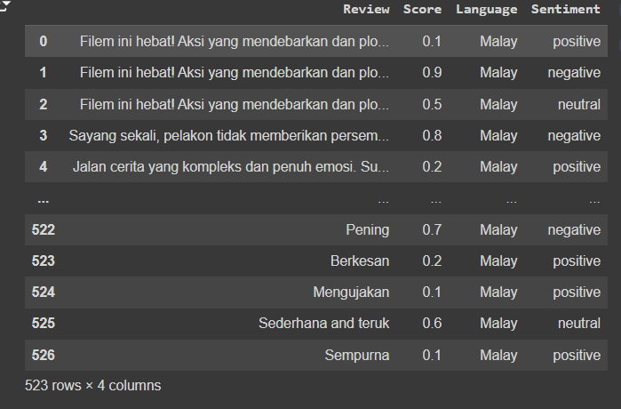
Classed different score into sentiment(positive neutral, negative)

Slide 22
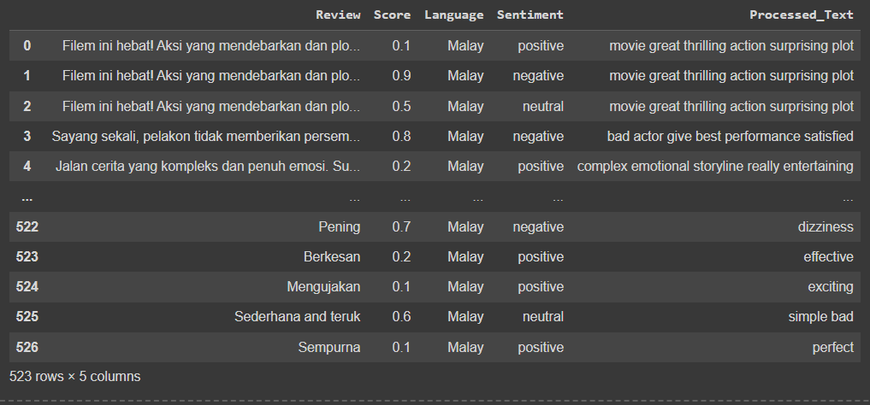
Translated, tokenized and lemmatized the data

Slide 23
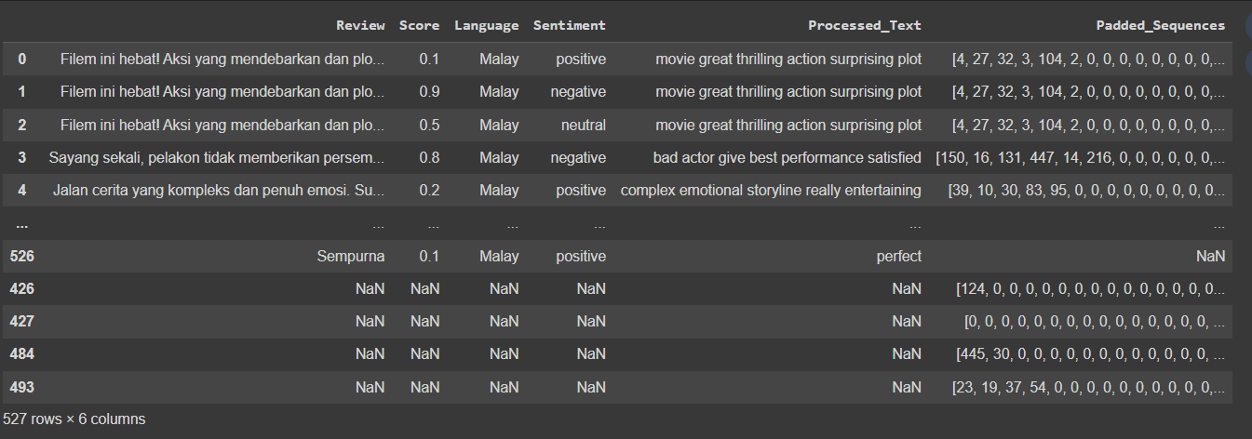
Pad and tokenize into numbers

Slide 24
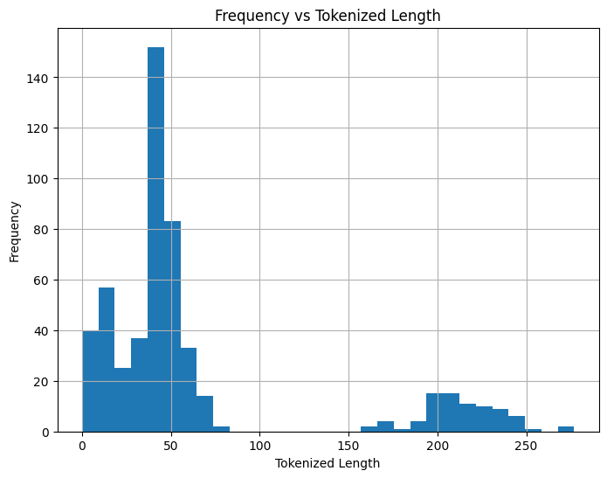
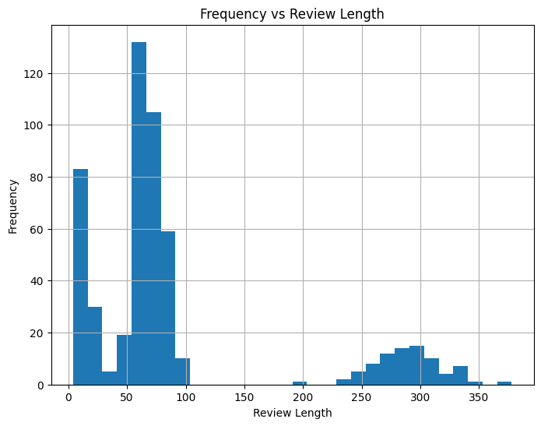
We removed many words which hopefully helps the model

Slide 25
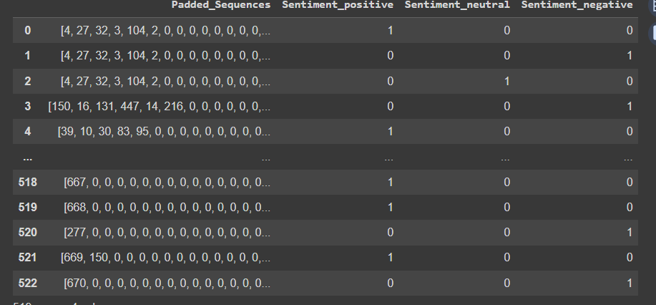
Onehot encode to form x and y

Slide 26
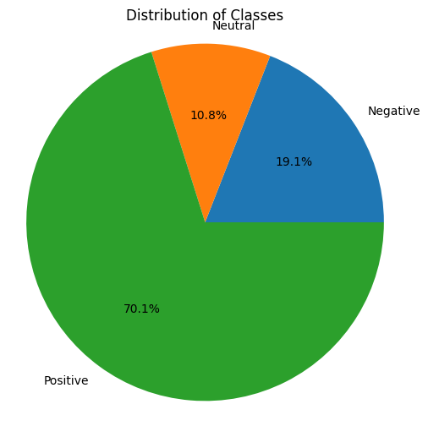
Distribution of classes not even

Slide 27
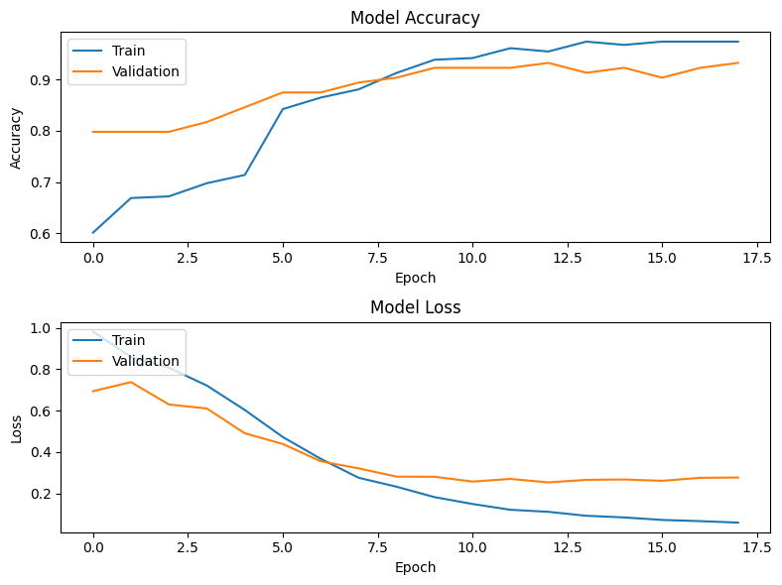
Trained on unbalanced dataset

Slide 28
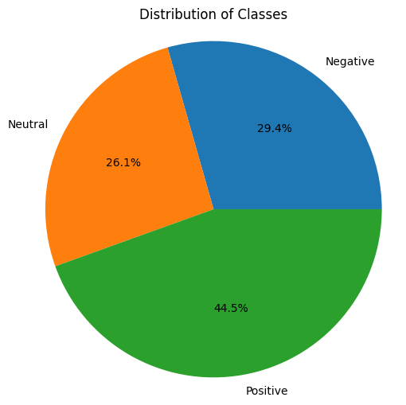
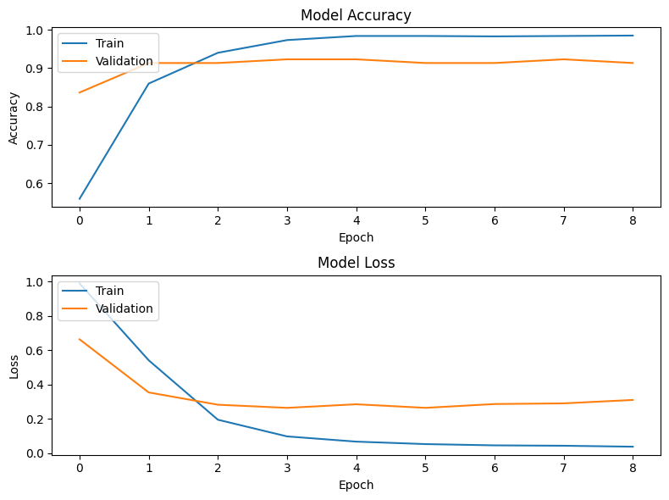
Even out through oversampling

Slide 29
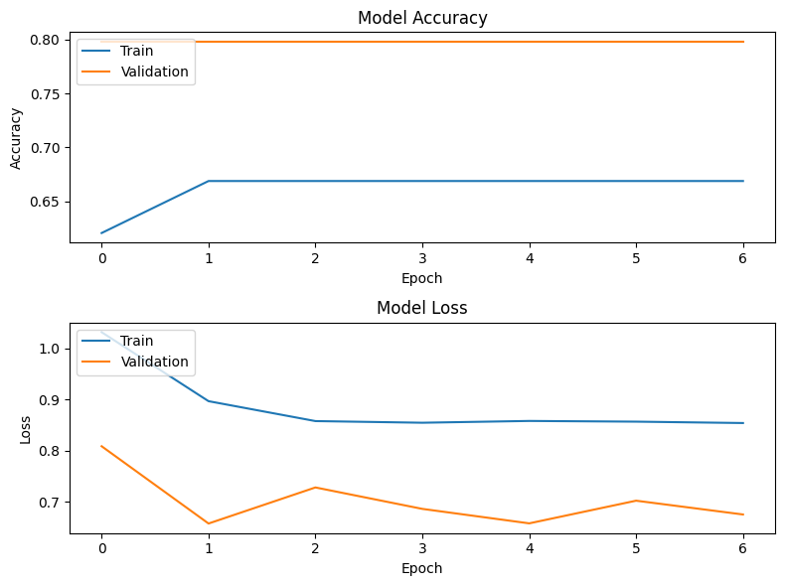
Model with gru layers

Slide 30
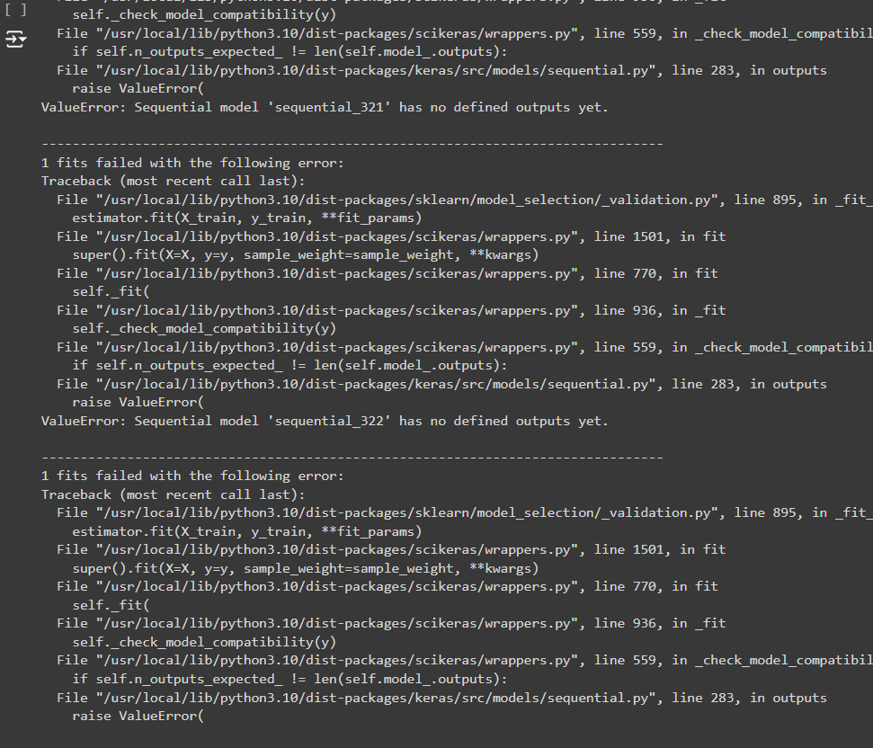
Hyperparameter tuning failed

Slide 31
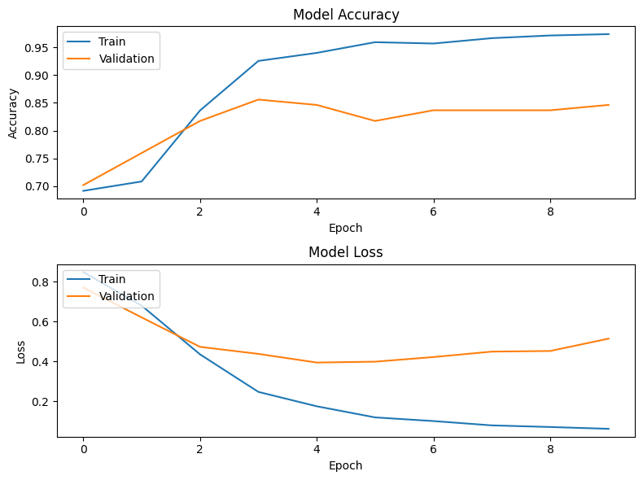
Final model

